Slide 1
Module 4
CONTROL LOGIC DESIGN: Control organization, Hardwired control, microprogram control, control of processor unit, micro-program sequencer, micro-programmed CPU organization, horizontal and vertical micro instructions,
Text :Hamacher C., Z. Vranesic and S. Zaky, Computer Organization ,5/e, McGraw Hill, 2011 Chapter 7
Mano M. M., Digital Logic & Computer Design , chapter 10

Slide 2
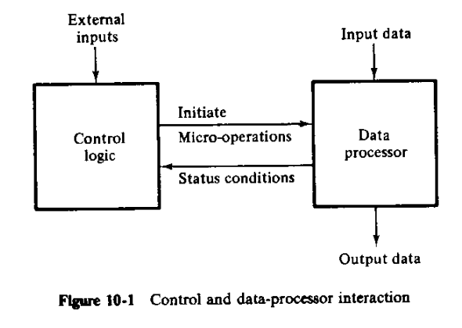
CONTROL LOGIC DESIGN

Slide 3
CONTROL LOGIC DESIGN
The binary information found in a digital system is stored in processor or memory registers, and it can be either data or control information.
The logic design of a digital system is a process for deriving the digital circuits that perform data processing and the digital circuits that provide control signals.
The timing for all registers in a synchronous digital system is controlled by a master-clock generator.
The clock pulses are applied to all flip-flops and registers in the system, including the flip-flops and registers in the control unit.
Two representations
Timing diagrams- clarifies the timing sequence and other relationships among the various control signals in the system.
Flowcharts - a convenient way to specify the sequence of procedural steps and decision paths for an algorithm

Slide 4
Control Organization
four methods of control organization
One flip-flop per state methods
Sequence register and decoder method
PLA control
Micro-program control
The first two methods result in a circuit that must use SSI and MSI circuits for the implementation.
A control unit implemented with SSI and MSI devices is said to be a hard-wired control.
If any alterations or modifications are needed, the circuits must be rewired to fulfill the new requirements.
The PLA or micro-program control which uses an LSI device such as a programmable logic array or a read-only memory.
Any alterations or modifications in a micro-program control can be easily achieved without wiring changes by removing the ROM from its socket and inserting another ROM programmed to fulfill the new specifications.

Slide 5
One flip-flop per state methods
This method uses one flip-flop per state in the control sequential circuit.
Only one flip-flop is set at any particular time: all others are cleared.
A single bit is made to propagate from one flipflop to the other under the control of decision logic.
In such an array, each flip-flop represents a state and is activated only when the control bit is transferred to it.

Slide 6
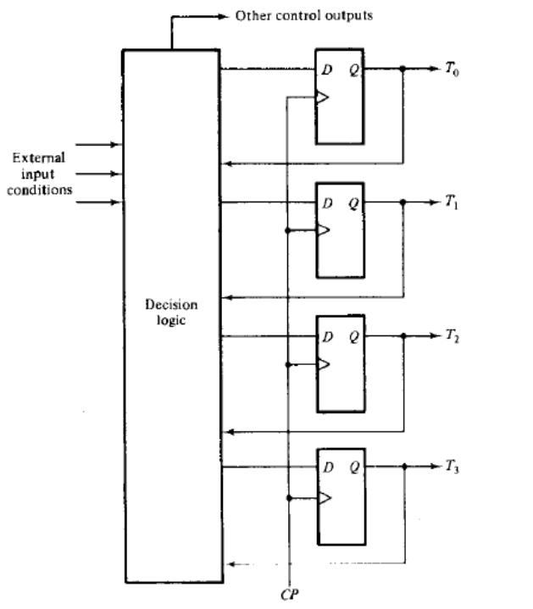
One flip-flop per state method
Maximum numbers of flipflops were used.
Example: A sequential circuit with 12 states requires a minimum of four flipflops because 23< 12< 24
Control circuit uses 12 flip-flops, one for each state

Slide 7
Sequence Register and Decoder Method
This method uses a register to sequence the control states.
The register is decoded to provide one output for each state.
For n flip-flops in the sequence register, the circuit will have 2^{n} states and the decoder will have 2^{n} outputs.
For example, a 4-bit register can be in any one of 16 states.
4 x 16 decoder will have 16 outputs, one for each state of the register.
Both the sequence register and decoder are MSI devices.

Slide 8
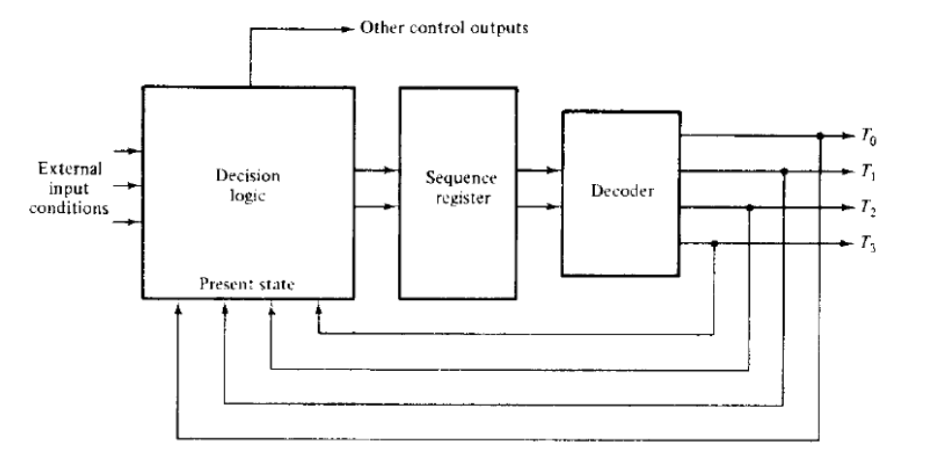
Sequence Register and Decoder Method

Slide 9
PLA control
The external sequence register establishes the present state of the control circuit.
The PLA outputs determine which micro-operations should be initiated depending on the external input conditions and the present state of the sequence register.
At the same time other PLA outputs determine the next state of the sequence register.

Slide 10
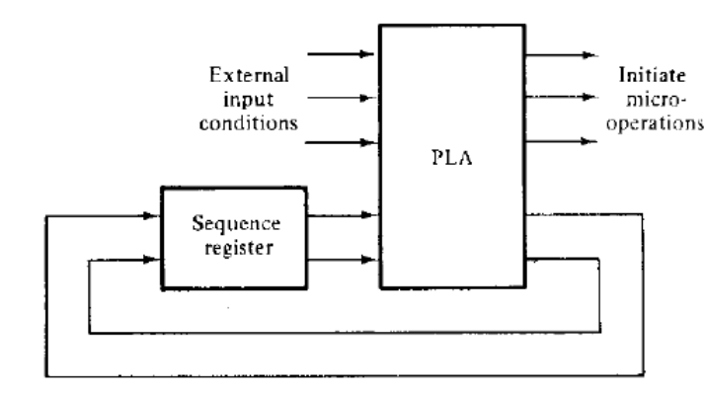
PLA control

Slide 11
Micro-program Control
The control variable at any given time can be represented by a string of 1's and 0's called control word.
A control unit whose control variables are stored in a memory called a micro-programmed control unit.
Each control word of memory is called Microinstruction and Sequence of microinstructions is called Micro-program.
Control memory is usually ROM since an alteration of micro-program is seldom needed.
The use of micro-program involves placing all control variables in words of the ROM for use by the control unit through successive read operations.
The content of the word in the ROM at a given address specifies the micro-operations for the system.

Slide 12
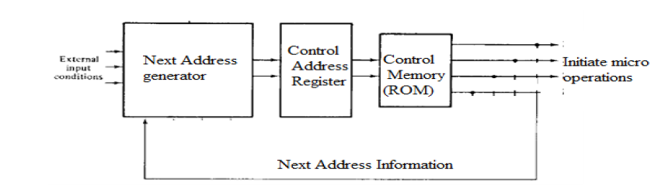
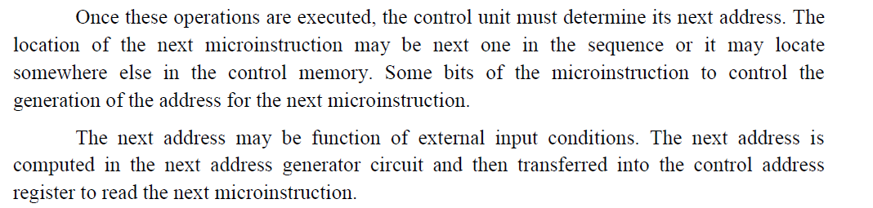

Slide 13
HARDWIRED CONTROL
The design of hardwired control is carried out in 5 consecutive steps
1. The problem is stated
2. An initial equipment configuration is assumed
3. An algorithm is formulated
4. The data processor part is specified
5. The control logic is designed

Slide 14
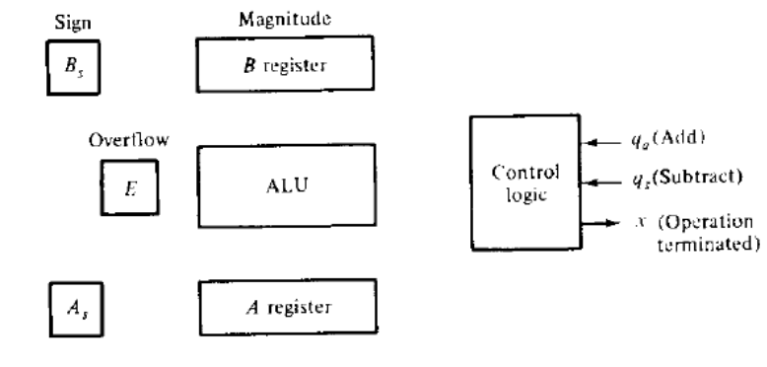
The two signed binary numbers to be added or subtracted contain n bits.
The magnitudes of the numbers contain k = n - 1 bits and are stored in registers A and B.
The sign bits are stored in flip-flops As and Bs.

Slide 15
HARDWIRED CONTROL
The control hardware can be viewed as a state machine that changes from one state to another in every clock cycle, depending on the contents of the instruction register, the condition codes and the external inputs.
The outputs of the state machine are the control signals.
The sequence of the operation carried out by this machine is determined by the wiring of the logic elements and hence named as “hardwired”.
Control logic derived in this section is a hardwired control of the one flip-flop per state method.
The design of hardwired control is carried out in 5 consecutive steps

Slide 16
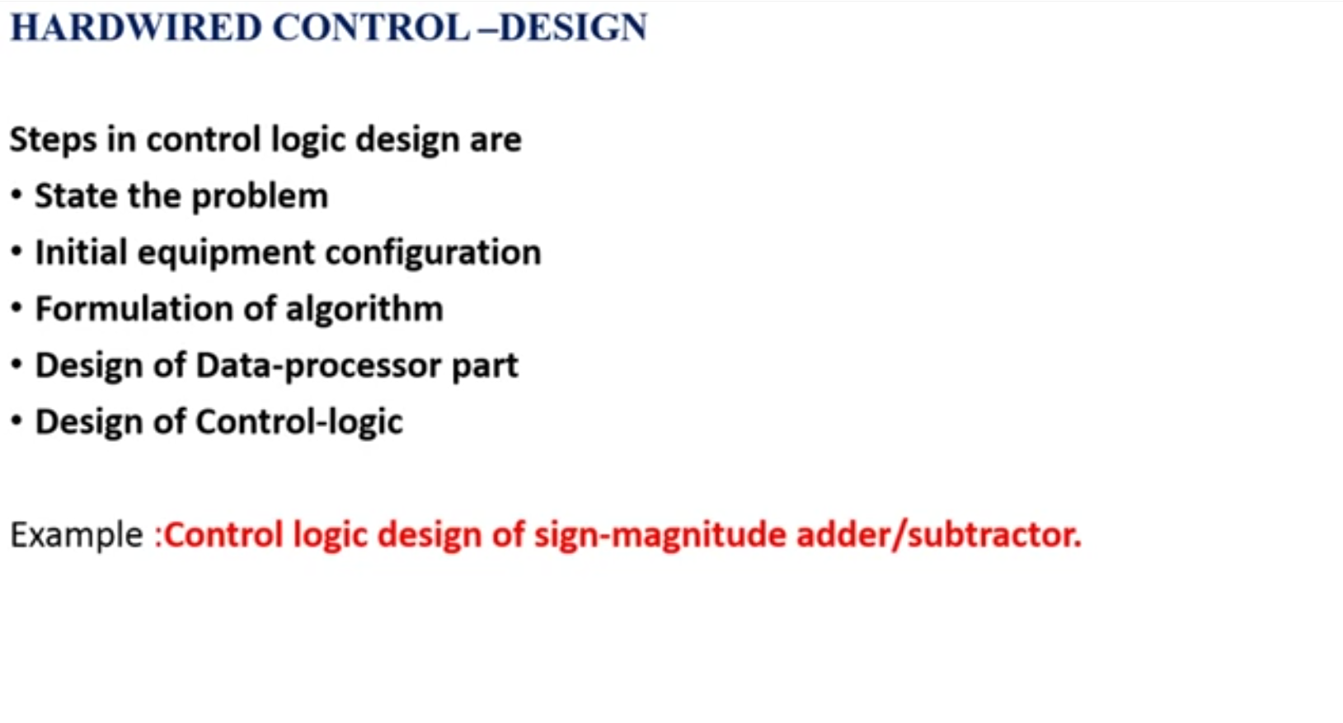

Slide 17
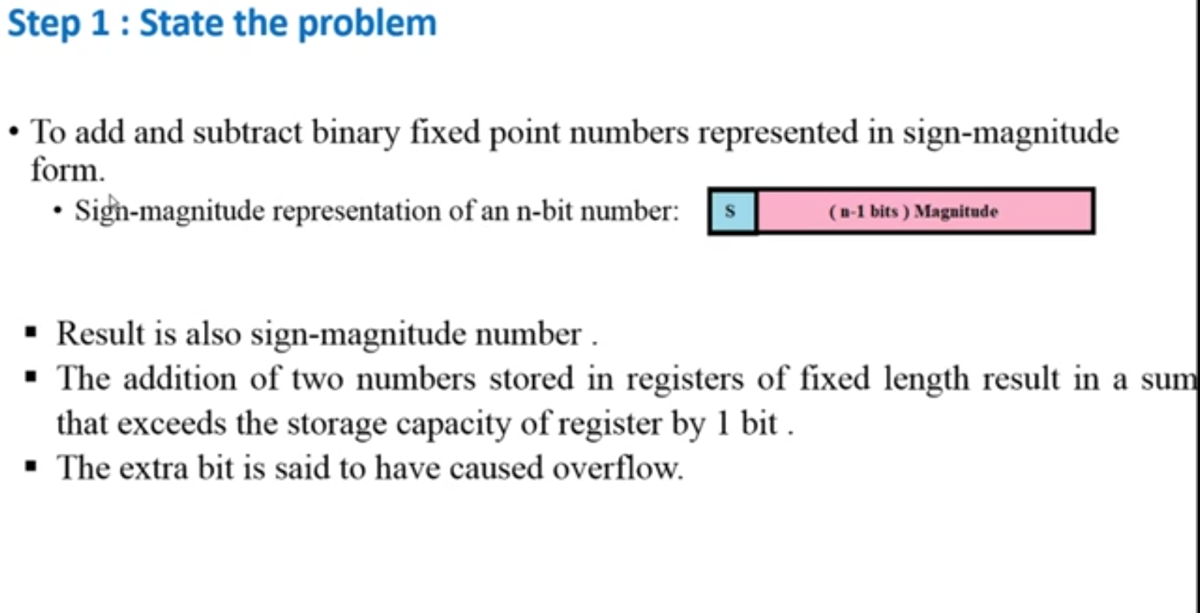

Slide 18
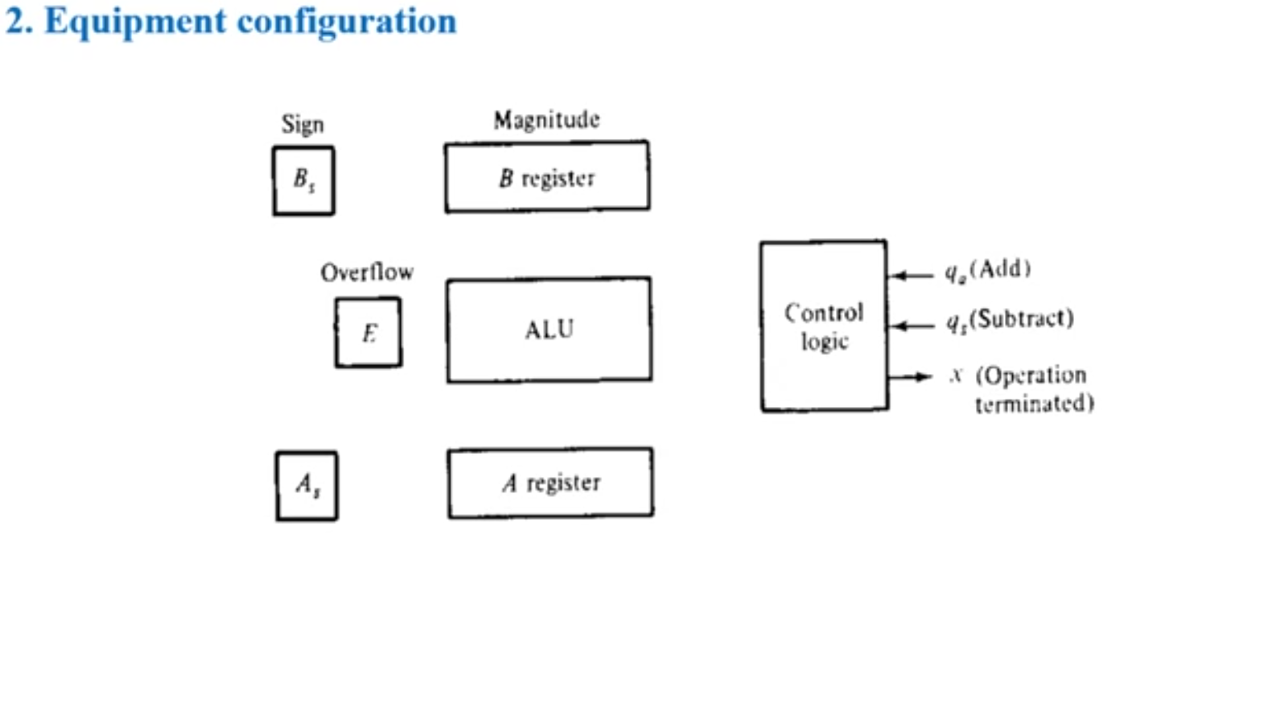

Slide 19
±A ± (±B )
If the arithmetic operation specified is subtraction, we change the sign of B and add.
This is evident from the relations:
±A − (+B) = ±A + (−B)
± A- (−B) = ±A + (+B)
This reduces the number of possible conditions to four, namely:
±A + (±B)

Slide 20
±A ± (±B )
If the arithmetic operation specified is subtraction, we change the sign of B and add.
This is evident from the relations:
±A − (+B) = ±A + (−B)
± A- (−B) = ±A + (+B)
This reduces the number of possible conditions to four, namely:
±A + (±B)

Slide 21
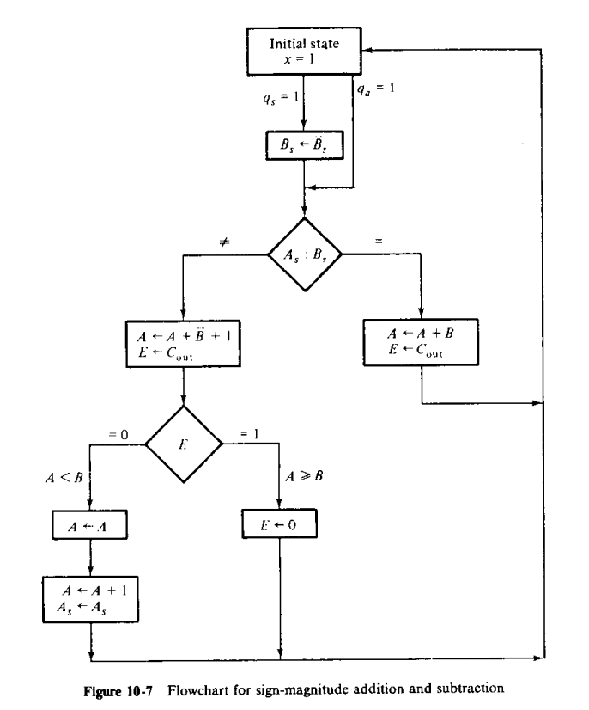

Slide 22
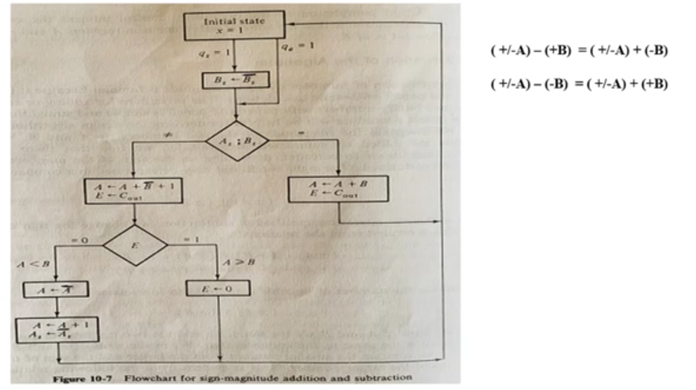

Slide 23
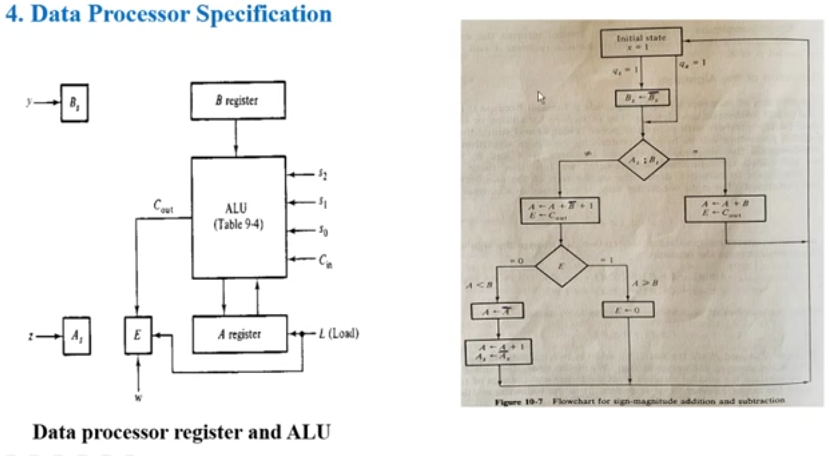

Slide 24
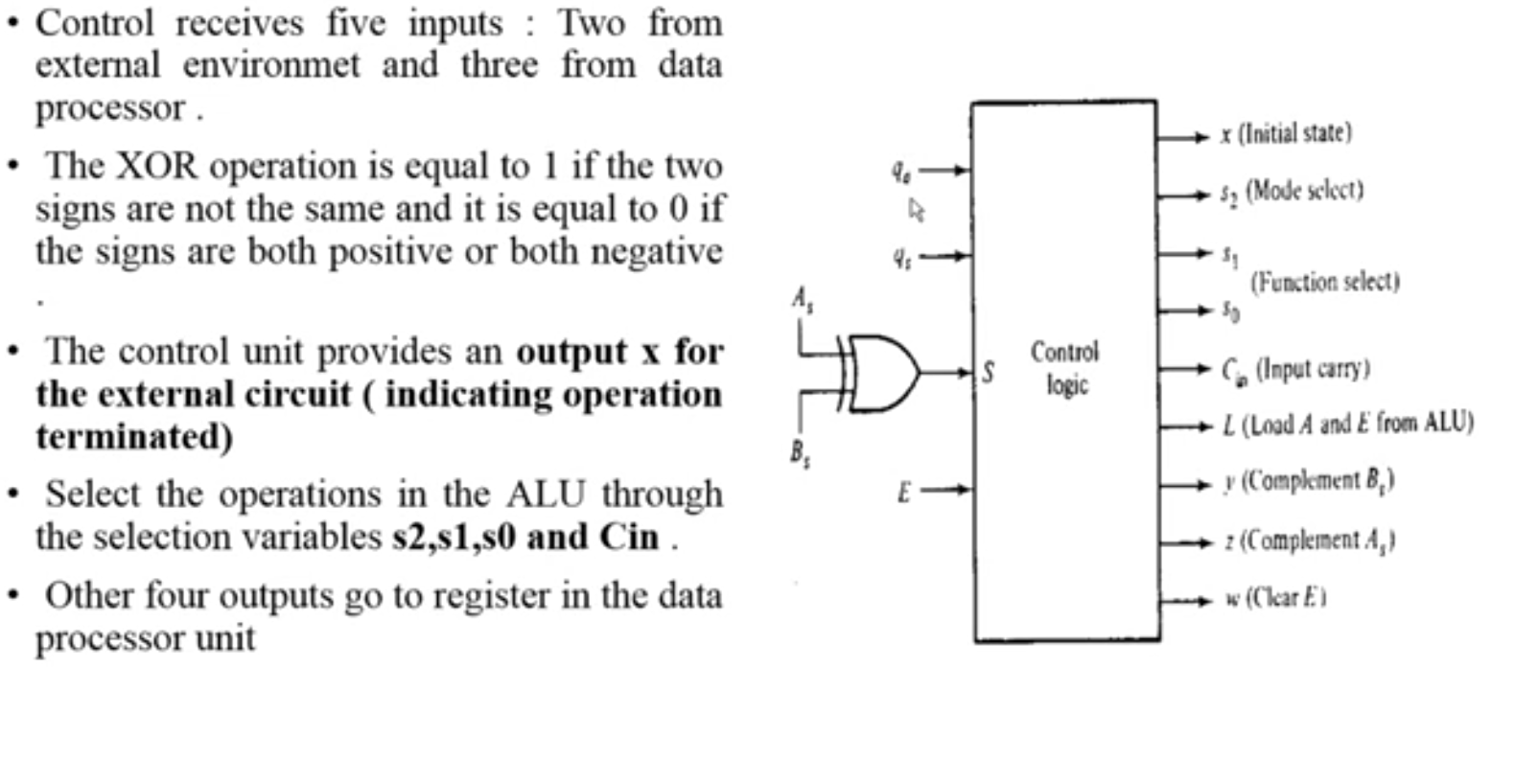

Slide 25
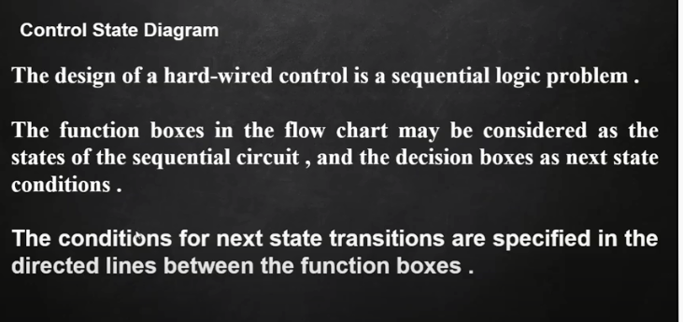

Slide 26
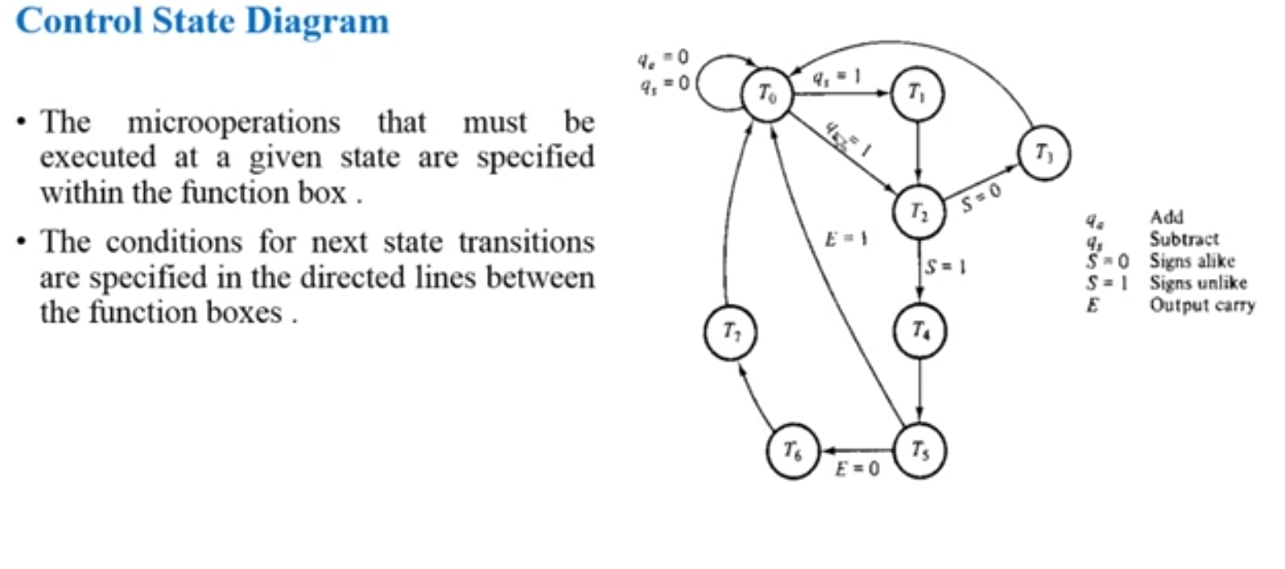

Slide 27
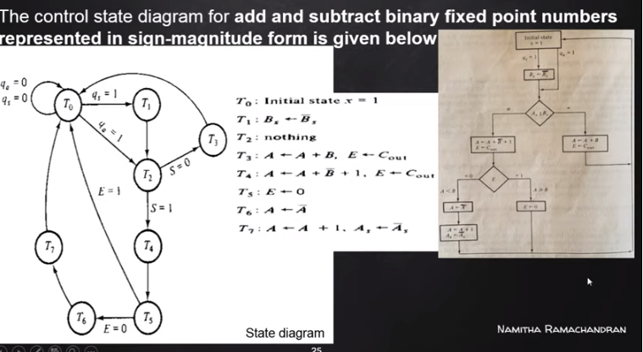

Slide 28
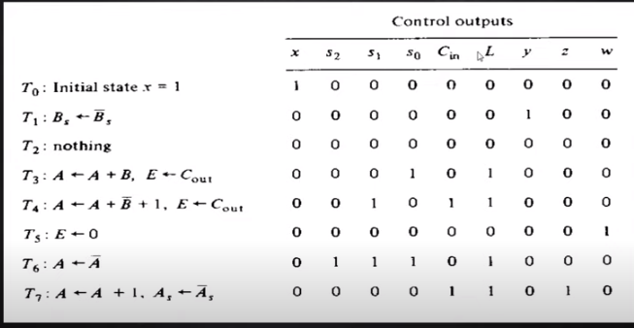

Slide 29
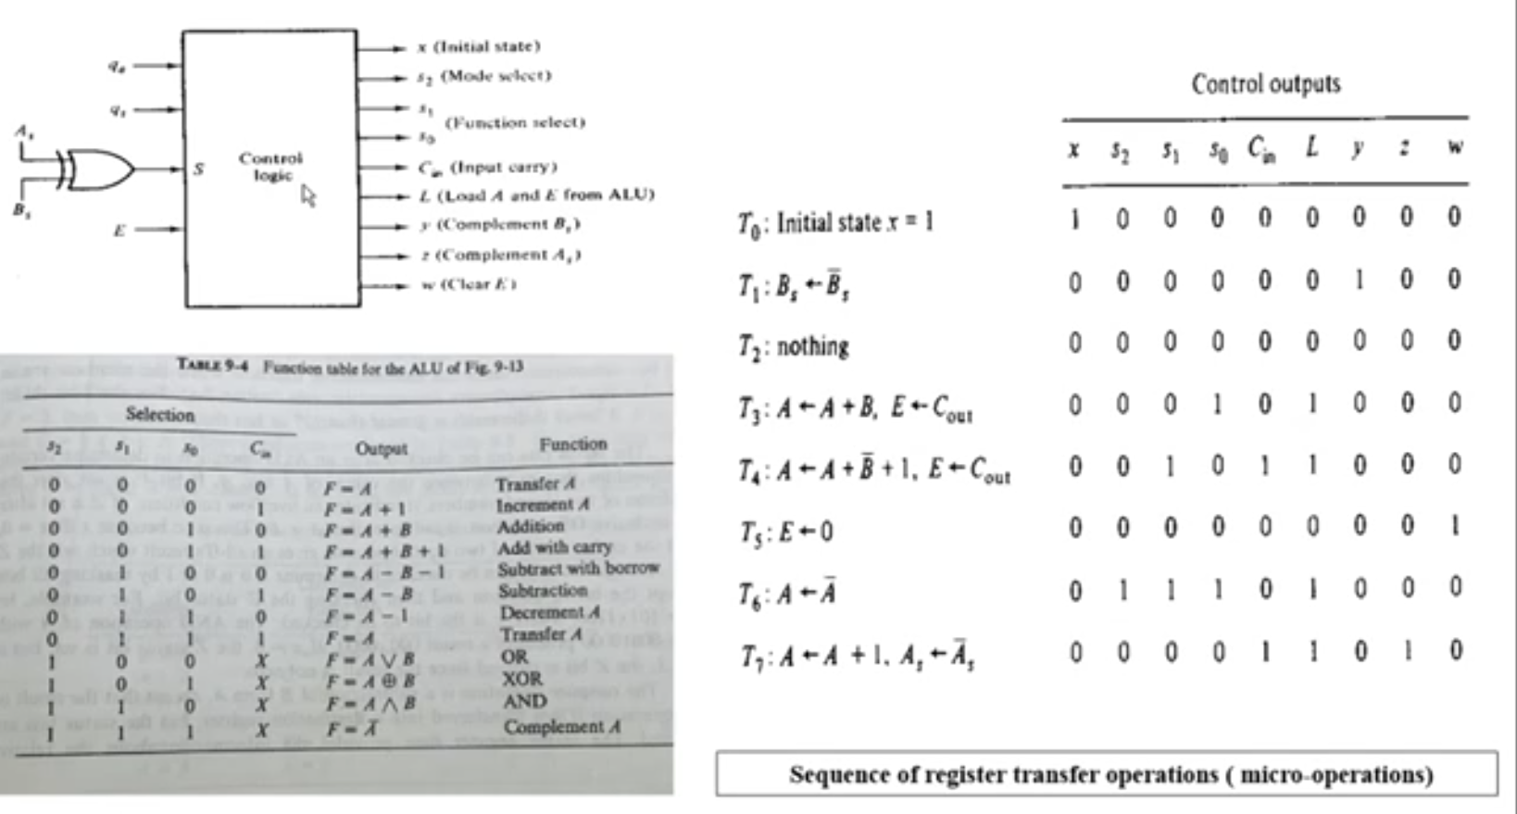

Slide 30
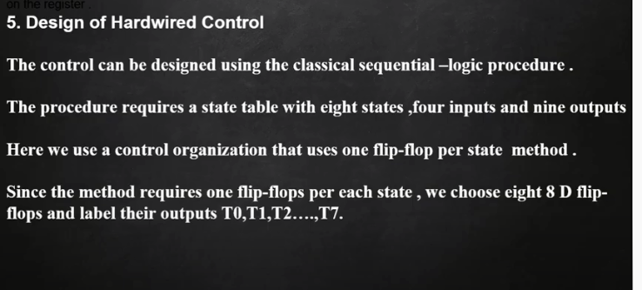

Slide 31
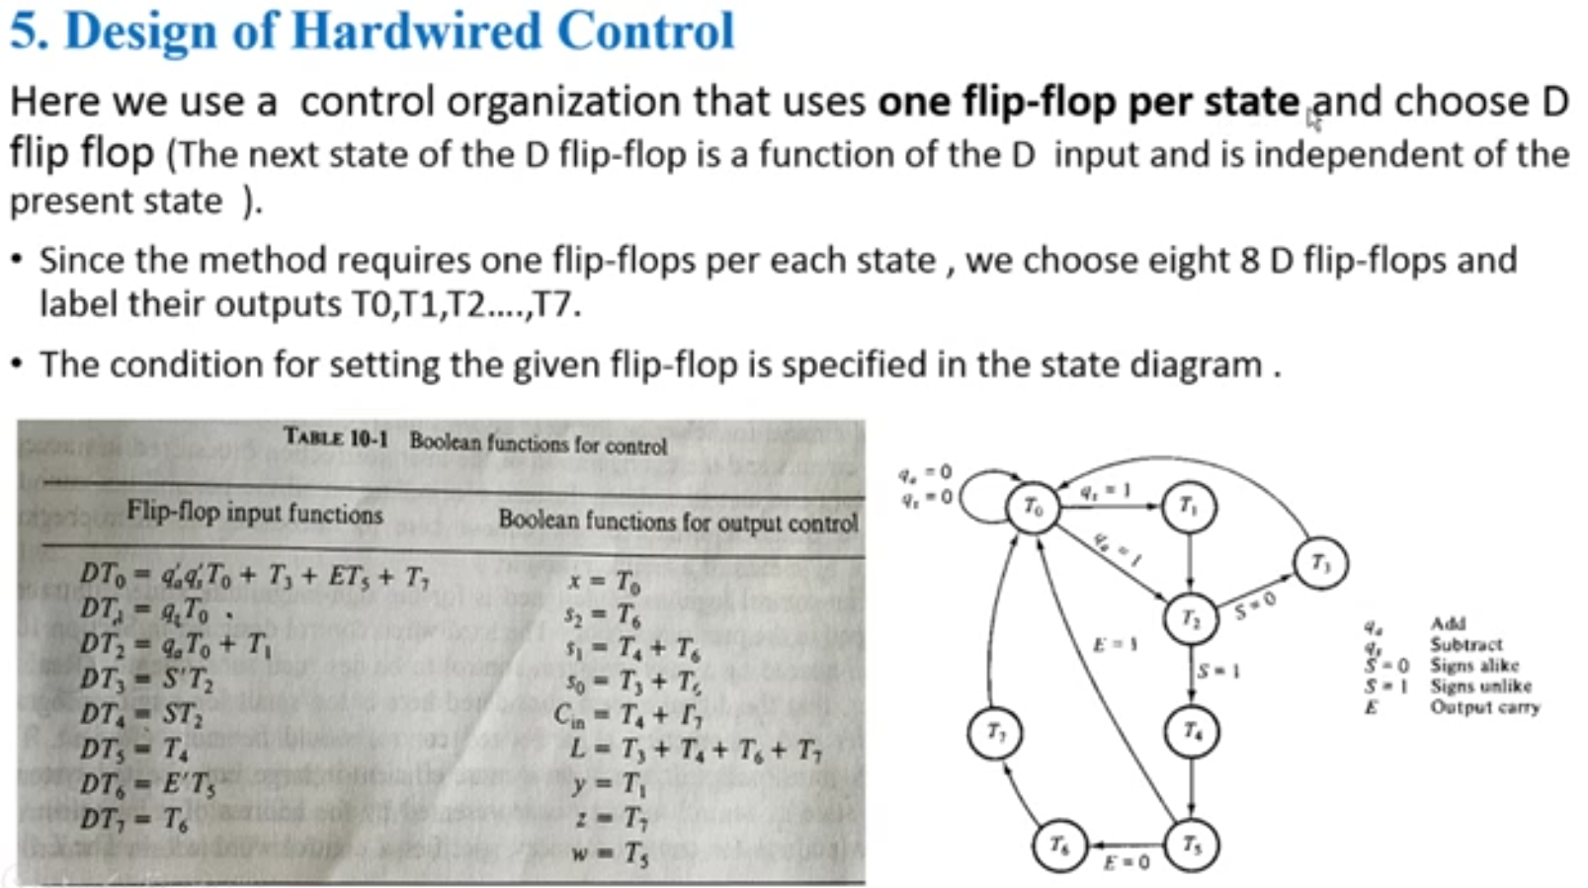

Slide 32
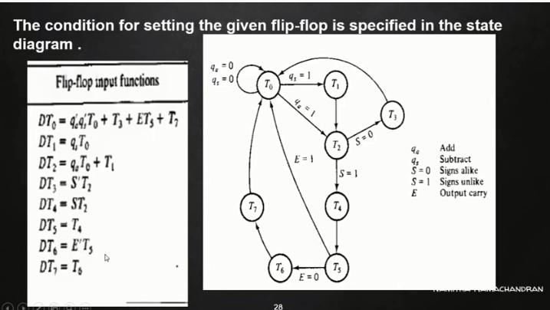

Slide 33
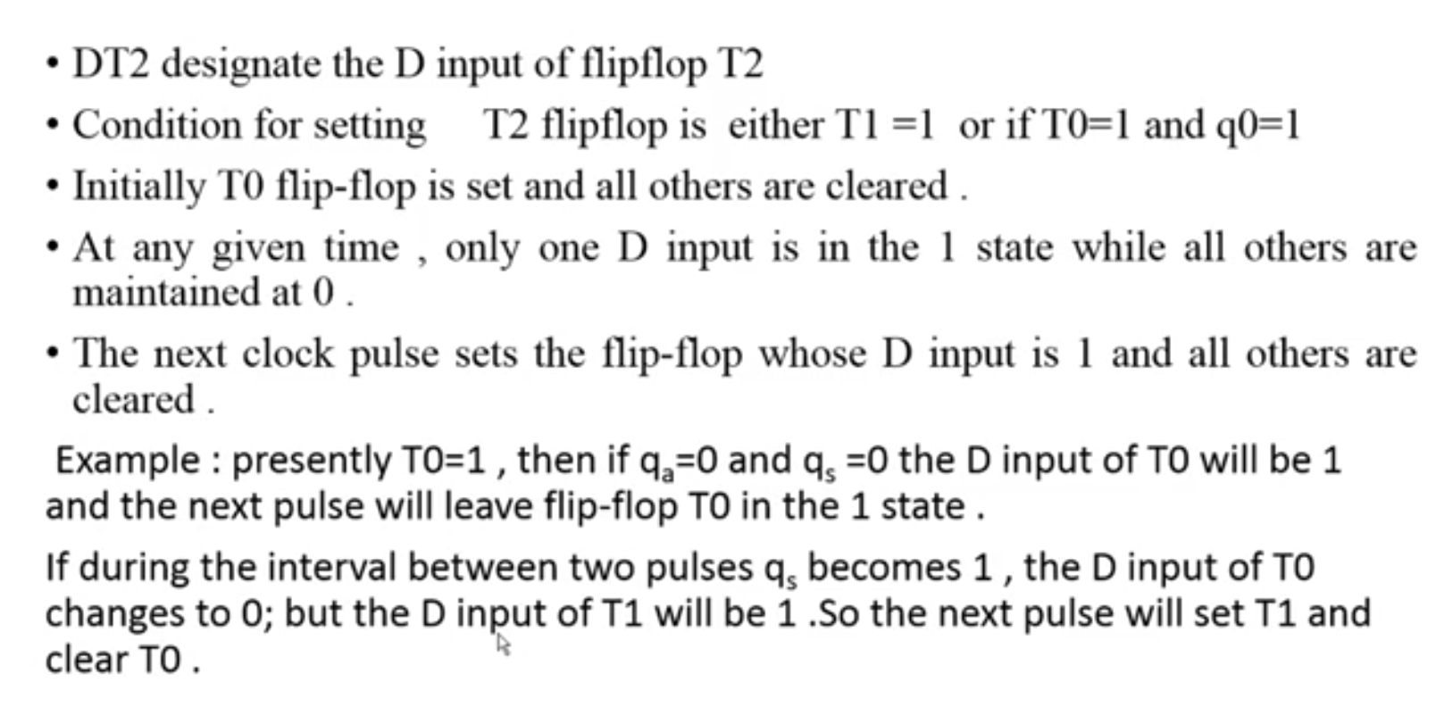

Slide 34
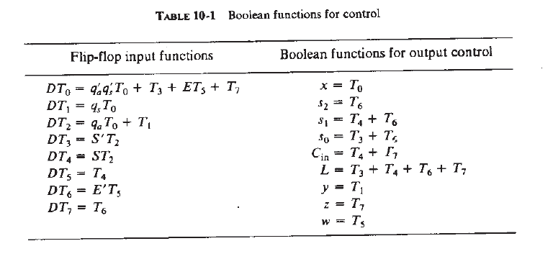

Slide 35
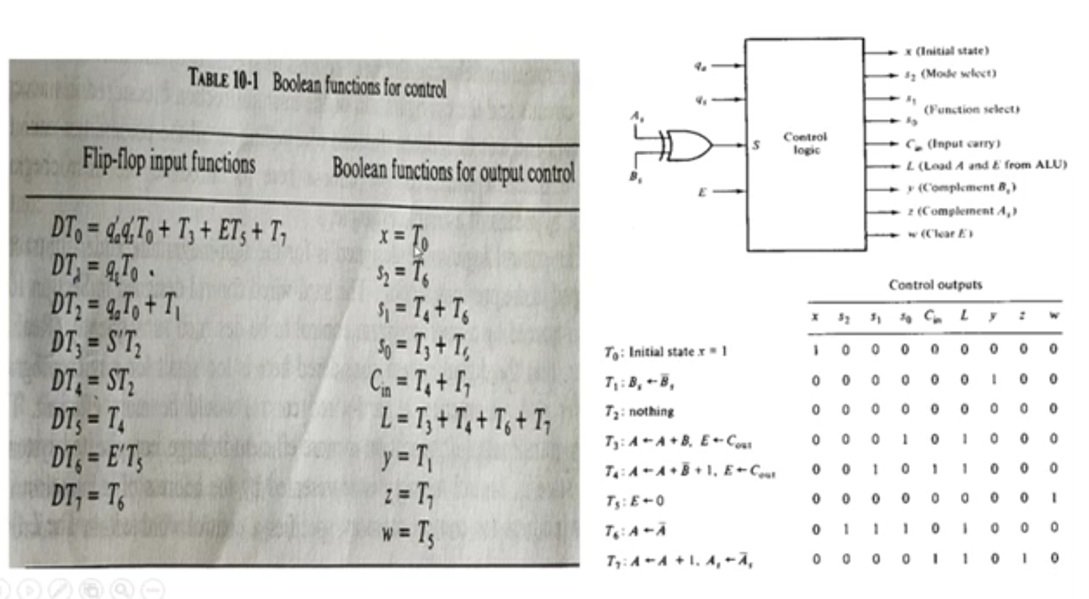

Slide 36

MICROPROGRAM CONTROL

Slide 37
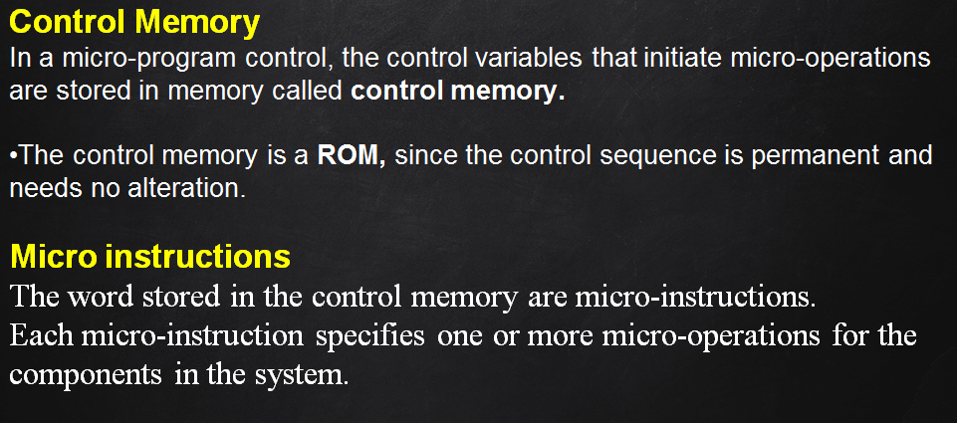

Slide 38
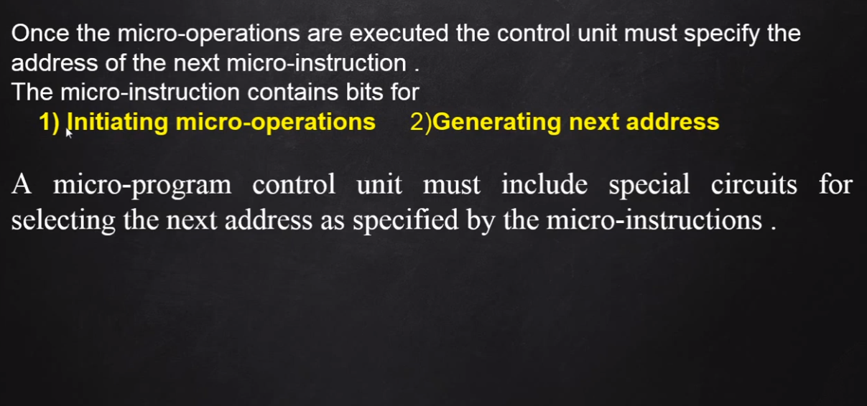

Slide 39
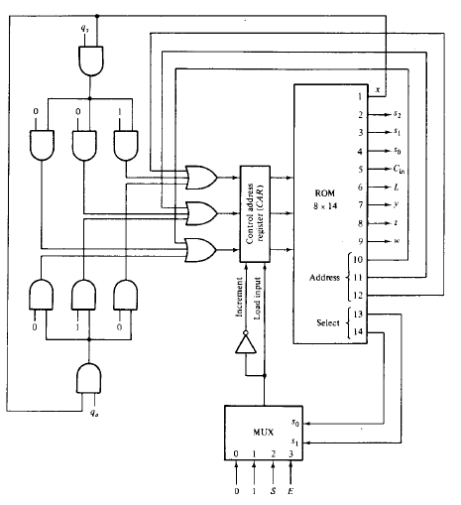
HARDWARE ORGANIZATION OF A MICRO-PROGRAM CONTROL UNIT

Slide 40
Hardware configuration
A state in control memory is represented by the address of a micro instruction.
An address for control memory specifies a control word within a microinstruction, just as a state in a sequential circuit specifies a microoperation.
Since there are 8 states in the control, we choose a control memory with 8 words having addresses 0 through 7.
The address of the control memory corresponds to subscript number under the T’s in the state diagram

Slide 41
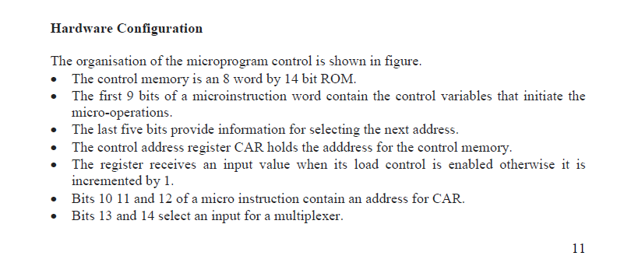
Bit 1 provides the initial state condition denoted by variable x and also enables an external address when qs and qa are equal to 1.

Slide 42
When x = 1, the address field of the micro instruction must be 000.
Then if qs =1, address 001 is available at the input of CAR
but if qa=1, address 010 is applied to CAR.
If both qs and qa are 0, the zero address from bits 10 11 and 12 are applied to the input of CAR.
In this way control memory stays at address 0 until an external variable is enabled.

Slide 43
The multiplexer has 4 inputs that are selected with 13 and 14 of the micro instruction. The functions of the multiplexer select bits are.
If bits 13 and 14 are 00, a multiplexer input that is equal to 0 is selected. The output of the multiplexer is 0 and increment input to CAR is enabled. This configuration increments CAR to choose the next address in the sequence.
An input of 1 is selected by the multiplexer when bits 13 and 14 are equal to 01. The output of the multiplexer is 1 and external input is loaded onto the CAR.
Status variable S is selected when bits 13 and 14 or equal to 10. If S=1, the output of the multiplexer is 1 and address bits of the micro instructions are loaded into CAR ( provided x=0). If S=0, the output of a multiplexer is 0 and CAR is incremented.
With bits 13 and 14 equal to 11, status variable E is selected and the address field is loaded into CAR. If E=1, but CAR is incremented if equal to 0.
Thus, the multiplexer allows the control to choose between two addresses depending on the value of the status

Slide 44
Microprogram
Once the configuration of a micro program control unit is established, the designer’s task is to generate the microcode for the control memory.
This code generation is called microprogramming and is a process that determines the bit configuration for each and all words in control memory.
The control memory has 8 word and each word contain 14 bits. To microprogram the control memory, we must determine the bit values of each of the eight words
The micro-operation sequence can be specified with the register transfer statements.

Slide 45
The address associated with each symbolic statement corresponds to the address where the micro instruction is to be stored in memory.
The sequencing from one address to the next can be indicated by means of conditional control statements.
This type of statement can specify the address to which control goes depending on status conditions.
Once the symbolic micro program is established, it is possible to translate the register transfer statements to their equivalent binary form

Slide 46
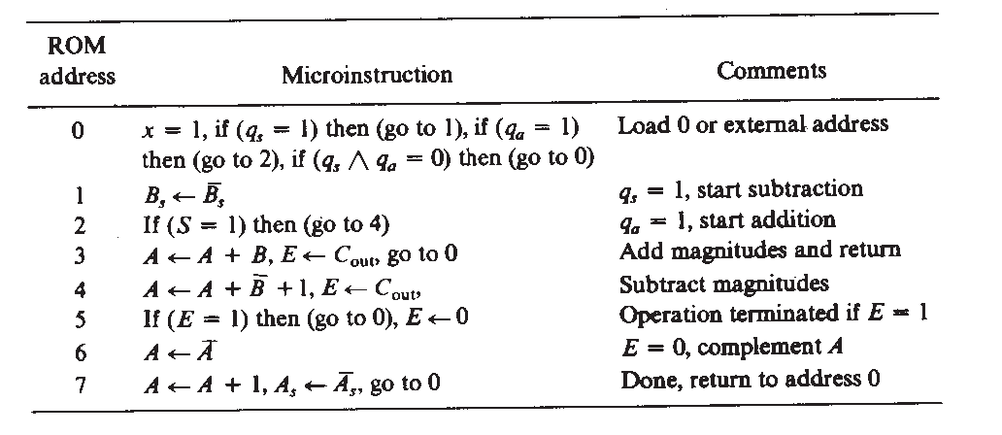

Slide 47
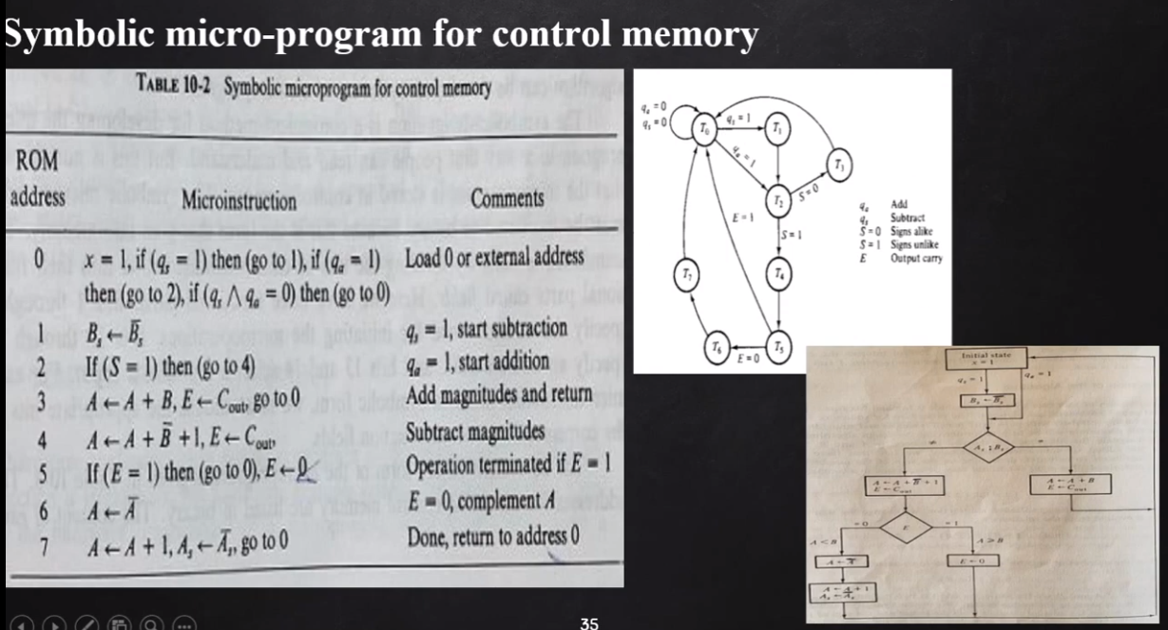

Slide 48
The symbolic microprogram must be translated to binary which in this form that goes into memory.
The translation is done by dividing the bits of each microinstruction into their functional parts called fields.
Here we have three functional parts.
Bits 1 through 9 specify the control word for initiating the micro operations.
Bits 10 through 12 specify address field
Bits 13 and 14 select multiplexer input.
For each microinstruction listed in symbolic form we must choose the appropriate bits in the corresponding microinstruction fields.

Slide 49
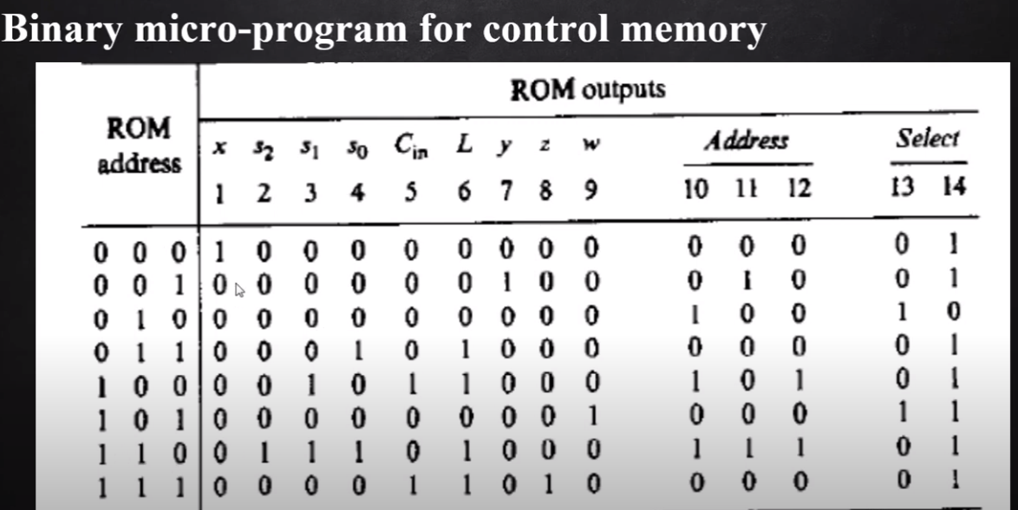

Slide 50
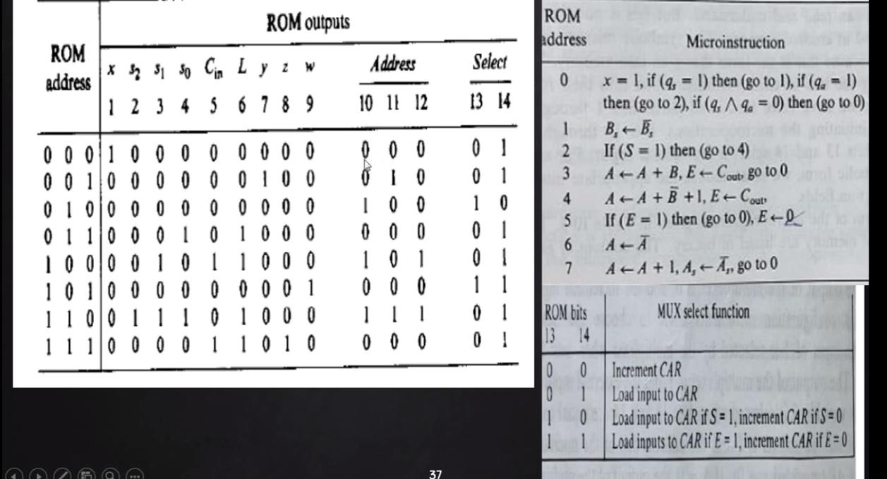

Slide 51
At address 000, we have 0 one for the select field. This allows an external address to be loaded into CAR if qs or qa is equal to 1. Otherwise address 000 is transferred to CAR.
In address 001, the microinstruction select field is 01 and address field is 010. From table in figure 10.10, we find that the clock pulse that indicates the microoperation Bs <- Bs ‘ also transfer the address field into CAR.
The next microinstruction out of ROM will be the one stored in address 010. The select field at address 001 could have been chosen to be 00. This would have caused CAR to increment and go to address 010.
Inspection of the select field in which 13 and 14 shows that when these two bits are equal to 01, the address field is next address.
When these two bits are 10, status variable S is selected and when they are 11, status variable E is selected.
In the last two cases the next address is the one specified in the address field if the selected status bit=1. If the selected status bit=0, the next address is one next in sequence because CAR is incremented.

Slide 52
Advantages of Micro programmed control
It simplifies the design of control unit. Thus it is both, cheaper and less error prone to implement.
Control functions are implemented in software rather than hardware.
The design process is orderly and systematic
More flexible, can be changed to accommodate new system specifications or to correct the design errors quickly and cheaply.
Complex function such as floating point arithmetic can be realized efficiently.

Slide 53
Disadvantages
A micro programmed control unit is somewhat slower than the hardwired control unit, because time is required to access the microinstructions from CM
The flexibility is achieved at some extra hardware cost due to the control memory and its access circuitry.

Slide 54
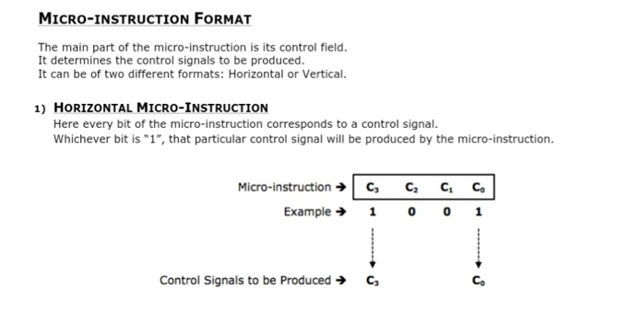

Slide 55
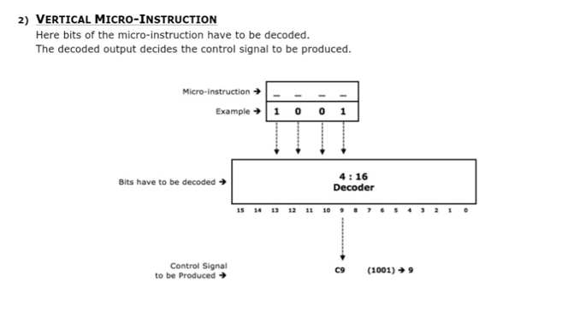

Slide 56
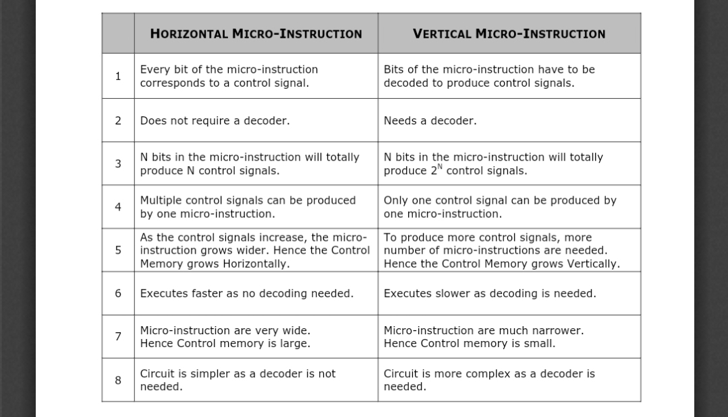

Slide 57
MICROPROGRAM SEQUENCER

Slide 58
Micro program sequencer is a control unit which does the tasks of Micro-program sequencing.
There are two important factors that must be considered while designing the micro program sequencer.
The size of the microinstruction
The address generation time.
Micro-program sequencer is attached to the control memory.
It inspects certain bits in the microinstruction to determine the next address for control memory.

Slide 59
Typical sequencer provides the following address-sequencing capabilities :
1.Increments the present address for control memory .
Sequential access: The content of address register of the control memory (CAR) is incremented after execution of each micro-instruction .
2. Branches to an address as specified by the address field of the microinstruction
3 . Branches to a given address if a specified status bit equal to 1.
4.Transfer control to a new address as specified by an external source .
The external address transfers control to the first microinstruction in a microprogram
5 .Support subroutine call and returns.
Placing return address into a stack and then branching to the beginning of the subroutine .After the execution of a subroutine the return address can be loaded to CAR from stack top and return the control to main program .

Slide 60
The address generation part is sometimes called a microprogram sequencer
since it sequences the micro instructions in control memory. Subroutines are programs used by other routines to accomplish a particular task.
Subroutine can be called from any point within the main body of the microprogram.

Slide 62
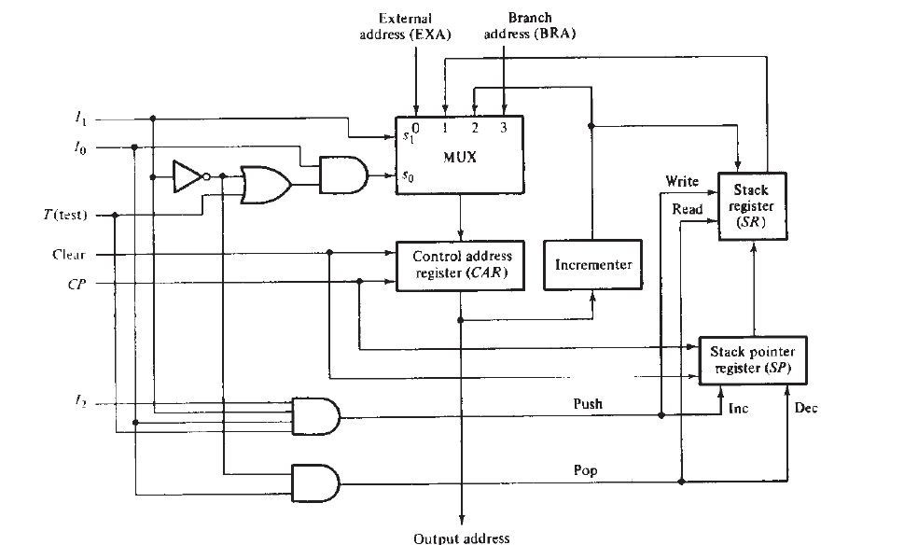
Block diagram of Micro-program Sequencer

Slide 63
It consists of a multiplexer that selects an address from four sources and routes it into a Control Address Register (CAR).
1. Transfers control to a new address specified by an external source (EXA).
2. Transfers control to a new address for subroutines call (SR) and returns.
3. Increments the present address of control memory (Incrementer)
4. Branches to an address which will be specified in the bits of microinstruction (BRA).

Slide 64
Multiplexer: Selects an address from four sources and routes it into CAR.
The output from CAR provides the address for control memory to read a microinstruction.
The contents of CAR are incremented and applied to the multiplexer and to the stack register file (SR).
The register selected in the stack is determined by stack pointer (SP).
Inputs (I0-I2) specify the operation for the sequencer and input.
T is the test point for a status bit.
Initially the address register is cleared to zero and clock pulse synchronizes the loading into registers.

Slide 66
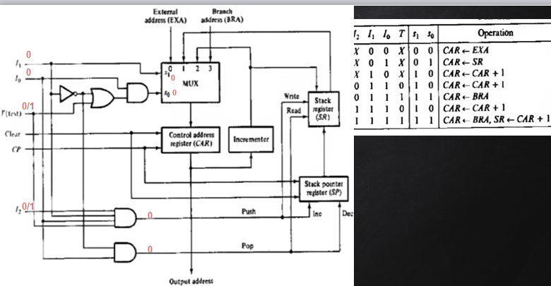

Slide 67
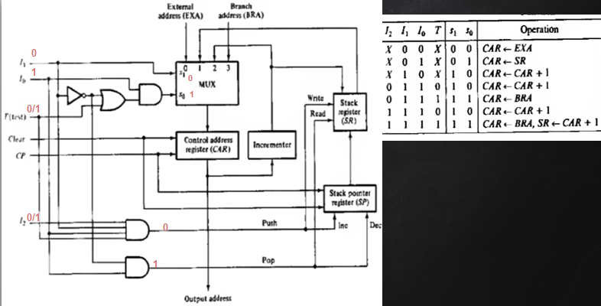

Slide 68


Slide 69


Slide 70


Slide 71
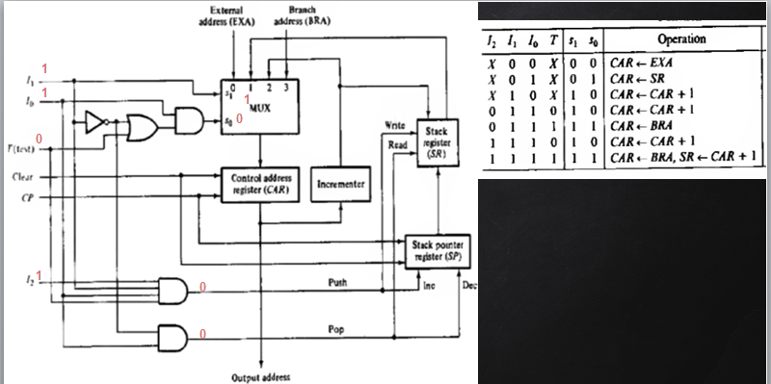

Slide 72
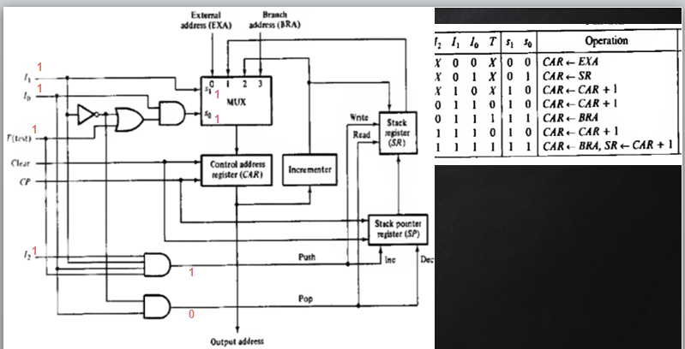

Slide 73
MICROPROGRAMMED CPU ORGANISATION OR MICROPROGRAMMED COMPUTER ORGANISATION

Slide 74
Digital computer consists of: Central Processing Unit(CPU), Memory unit and Input-output devices.
CPU can be divides into 2 distinct and interactive sections namely
Processing section: useful device for constructing the processor section of a CPU and
Control section: controlling the entire units of computer
Micro-program sequencer: constructing a micro-program control of CPU

Slide 75
Micro-programmed computer CPU uses the micro-program sequencer. Micro-programmed computer consists of
1. Memory unit: Stores instructions and data supplied by the user through an input device
2. Two processor unit:
Data processor: Manipulates data
Address processor: Manipulates the address information received from memory
3. A Micro-program sequencer
4. A control memory
5. Other digital functions

Slide 76
An instruction extracted from memory unit during fetch cycle goes into instruction register and is decoded.
The instruction-code bits in the instruction register specify a macrooperation for control memory .
Corresponding to each opcode (Add, sub), there will be a micro routine in the control memory.
Code transformation constitutes a mapping function that is needed to convert the op code bits of an instruction into a starting address for the control memory.
It is implemented with ROM or PLA.
Mapping concept provides flexibility for adding instructions or micro-operations for control memory as need arises.
The address generated in code transformation mapping function is applied to the external address (EXA) input of the sequencer

Slide 77
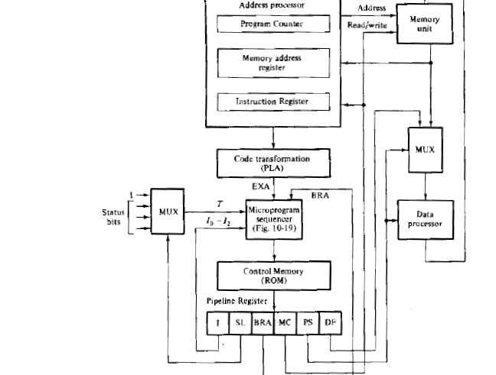

Slide 78
Micro-program control unit consists of
1. The sequencer: Generates next address
2. A control memory: Reads the next microinstruction while present microinstruction are being executed in the other units of the CPU and for storing microinstructions
3. A multiplexer: Selects one of the many status bits and applies to the T(test) input of the sequencer. One of the input of the multiplexer is always I to provide an unconditional branch operation

Slide 79
pipeline register:
Speed up the control operation, allows next address to be generated and the output of control memory to change while the current control word in pipeline register initiates the micro-operations given by present microinstruction.
It’s not always necessary because the output of control memory can go directly to the control inputs of the various units in the CPU

Slide 80
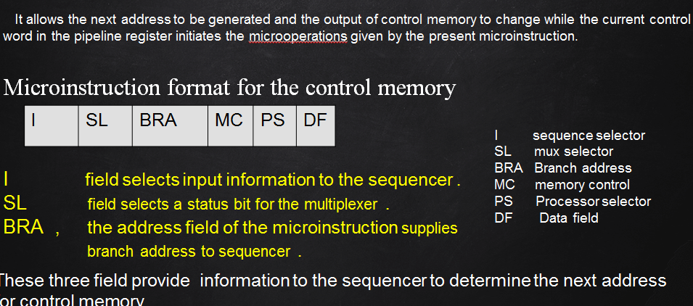

Slide 81
Microinstruction format contains six fields:
First 3 fields (I,SL, BRA) provide information to the sequencer to determine the next address for control memory.
I field (3 bits): Supplies input information for the sequencer
SL field: Selects a status bit for the multiplexer
BRA field: Address field of microinstruction and supplies a branch address (BRA) to the sequencer.
The next 3 fields (MC, PS, DF) are for controlling micro-operations in the processor and the memory units
Memory control (MC) field: Controls the address processor and the read and write operations in the memory unit.

Slide 82
The processor select(PS) field: Controls the operations in the data processor unit.
The data field(DF): Used to introduce constants into the processor. Output from data field may be used to set up control registers and introduce data in processor registers.
this field value is used to set up control registers and introduce data in processor registers .
data field value is used to sequence counter ,which is used to count the number of times a microprogram loop is traversed

Slide 83
Once the hardware configuration of a microprogrammed CPU is established the designer can use it to construct any possible computer configuration .
If a different computer with a different set of instructions is desired ,for that no hardware changes are required ,need to change the microprogram in control memory .
This involves removing present Control ROM memory and replacing another unit with different microprogram .

